Slide 1

Smart Egg Candling System
By:
Karim Nasir Abdul
[June 2020]

Slide 2


A project submitted in partial fulfilment of the requirement for the award
of the degree of BSc. (Hons) Computing Science
From Coventry University
Supervised by:
Dr. Lempogo Forgor
[June 2020]

Slide 3
NOTICE
This presentation is apart of the smart egg candling system, purposely to demonstrates the system in operation.
The presentation is organized as presented below:
1. Set-up for the android app (Smart Egg)
2. Preparation of the Egg Candling Unit.
3. The system under Operation.
NB: 3 eggs were utilized in this presentation. Two were of late stages, with one of early stage. Middle stage eggs weren’t present during this presentation.

Slide 4
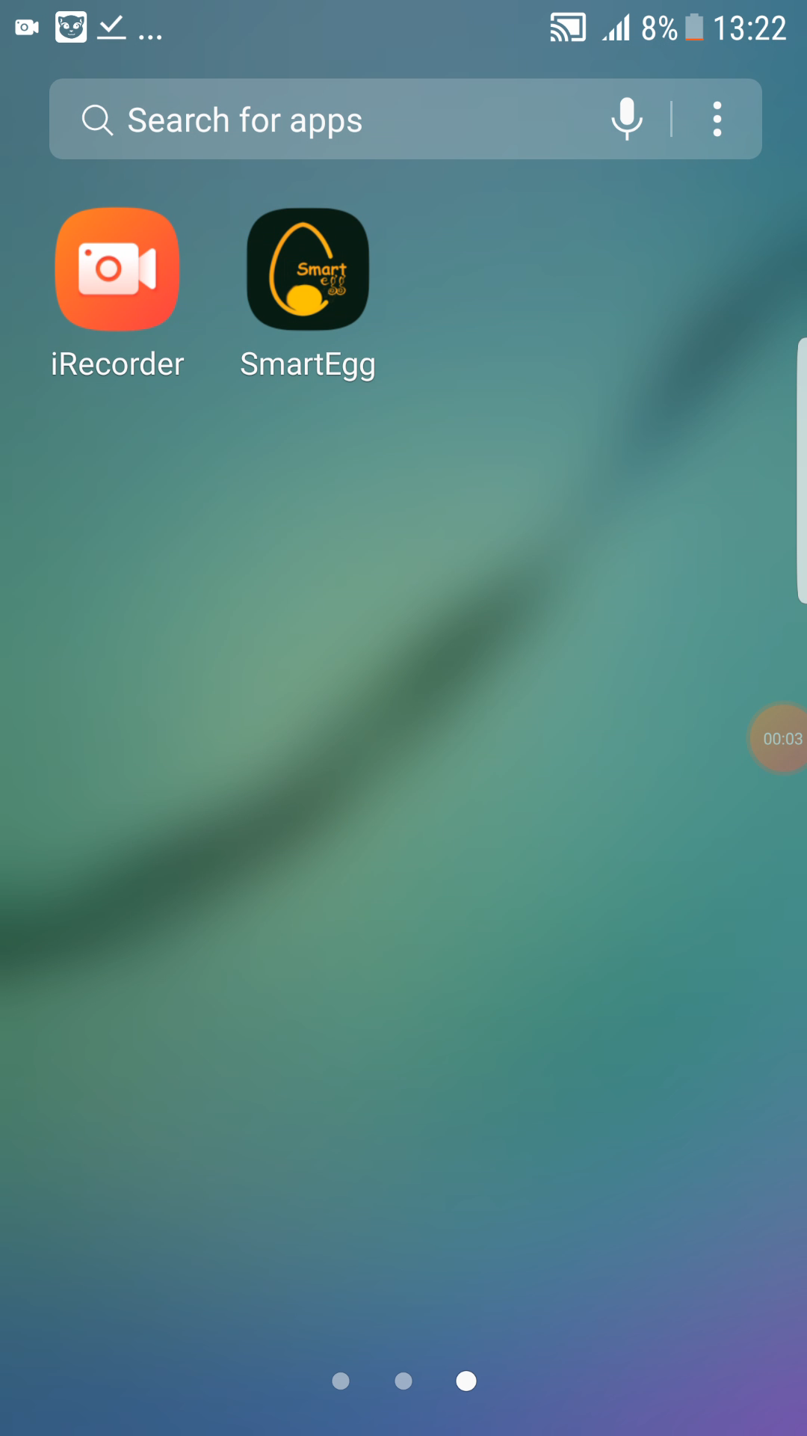
1. SET-UP FOR THE ANDROID APP (SMART EGG)
Video Demo of the set-up

Slide 5
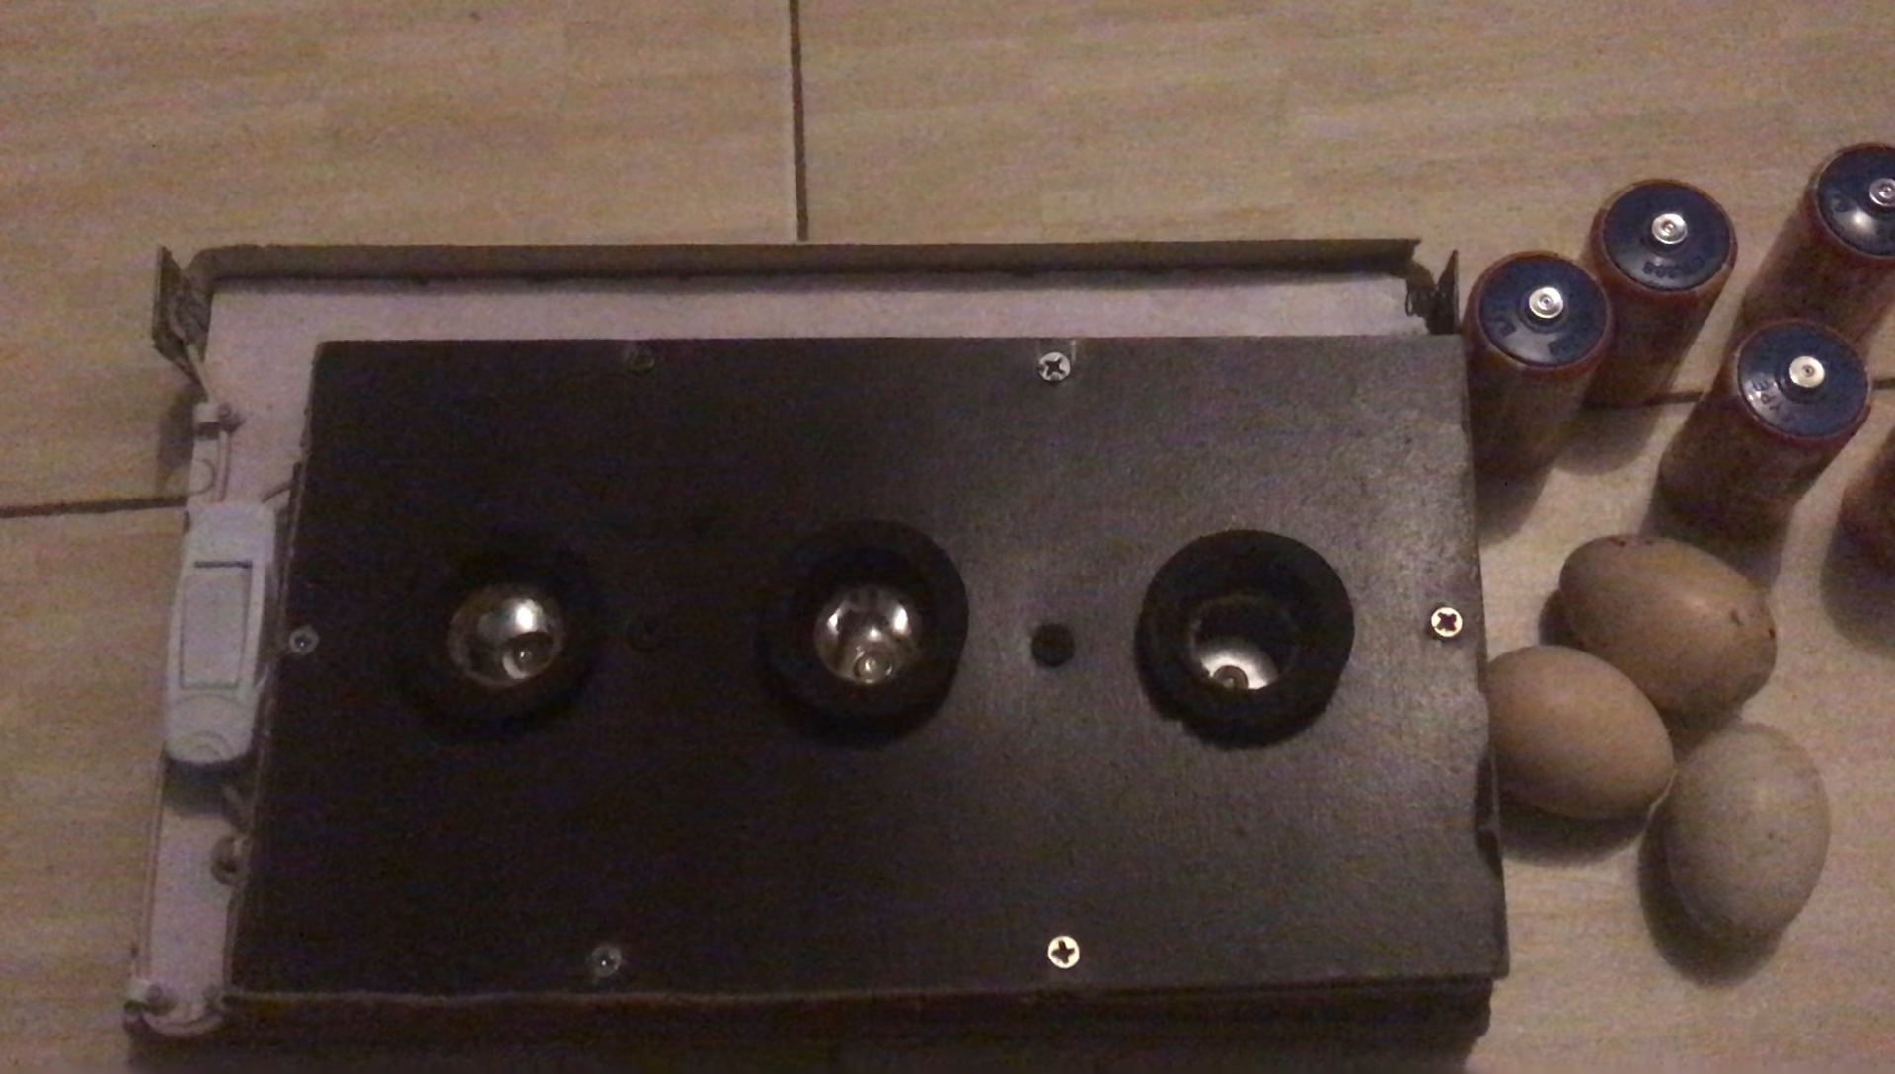
2. Preparation of the Egg Candling Unit
Video Demo of the set-up

Slide 6

The system under Operation.
Video Demo of the system in operation
NB: Internet was off during this demonstration.

Slide 7
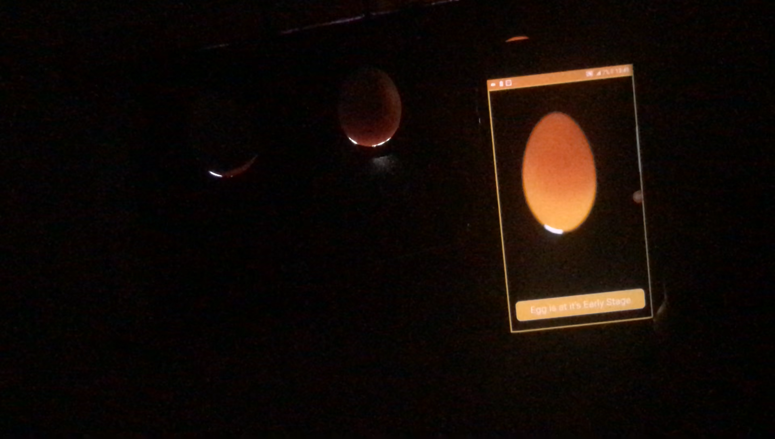
THE SYSTEM UNDER OPERATION (A DISTANCE VIEW).
A more distance view of the system in operation

Slide 8
Summary
In this Presentation, Three Eggs were classified using the smart egg candling system. Two had the results of “late Stage”, with one as “Early Stage”.
Internet wasn’t used, and the classification was as fast as less than 3 seconds.

Slide 9
The end
THANK YOU

